Slide 1
AI – Prof. R.G.Mehta
Brief introduction to AI
Goal-based agents
Representing states and operators
Example problems
Generic state-space search algorithm

Slide 2
Some Game Problems

Slide 3
Water Jug Problem
Given a full 5-gallon jug and an empty 2-gallon jug, the goal is to fill the 2-gallon jug with exactly one gallon of water.
Operator table
Name | Con d. | Transition | Effect
Empty5 | – | (x,y)→(0,y) | Empty 5-gal. jug
Empty2 | – | (x,y)→(x,0) | Empty 2-gal. jug
2to5 | x ≤ 3 | (x,2)→(x +2,0) | Pour 2-gal. into 5-gal.
5to2 | x ≥ 2 | (x, 0)→(x-2,2) | Pour 5-gal. into 2-gal.
5to2part | y < 2 | (1,y)→(0,y +1) | Pour partial 5- gal. into 2-gal.
State = (x,y), where x is the number of gallons of water in the 5-gallon jug and y is # of gallons in the 2-gallon jug
Initial State = (5,0)
Goal State = (*,1), where
* means any amount

Slide 4
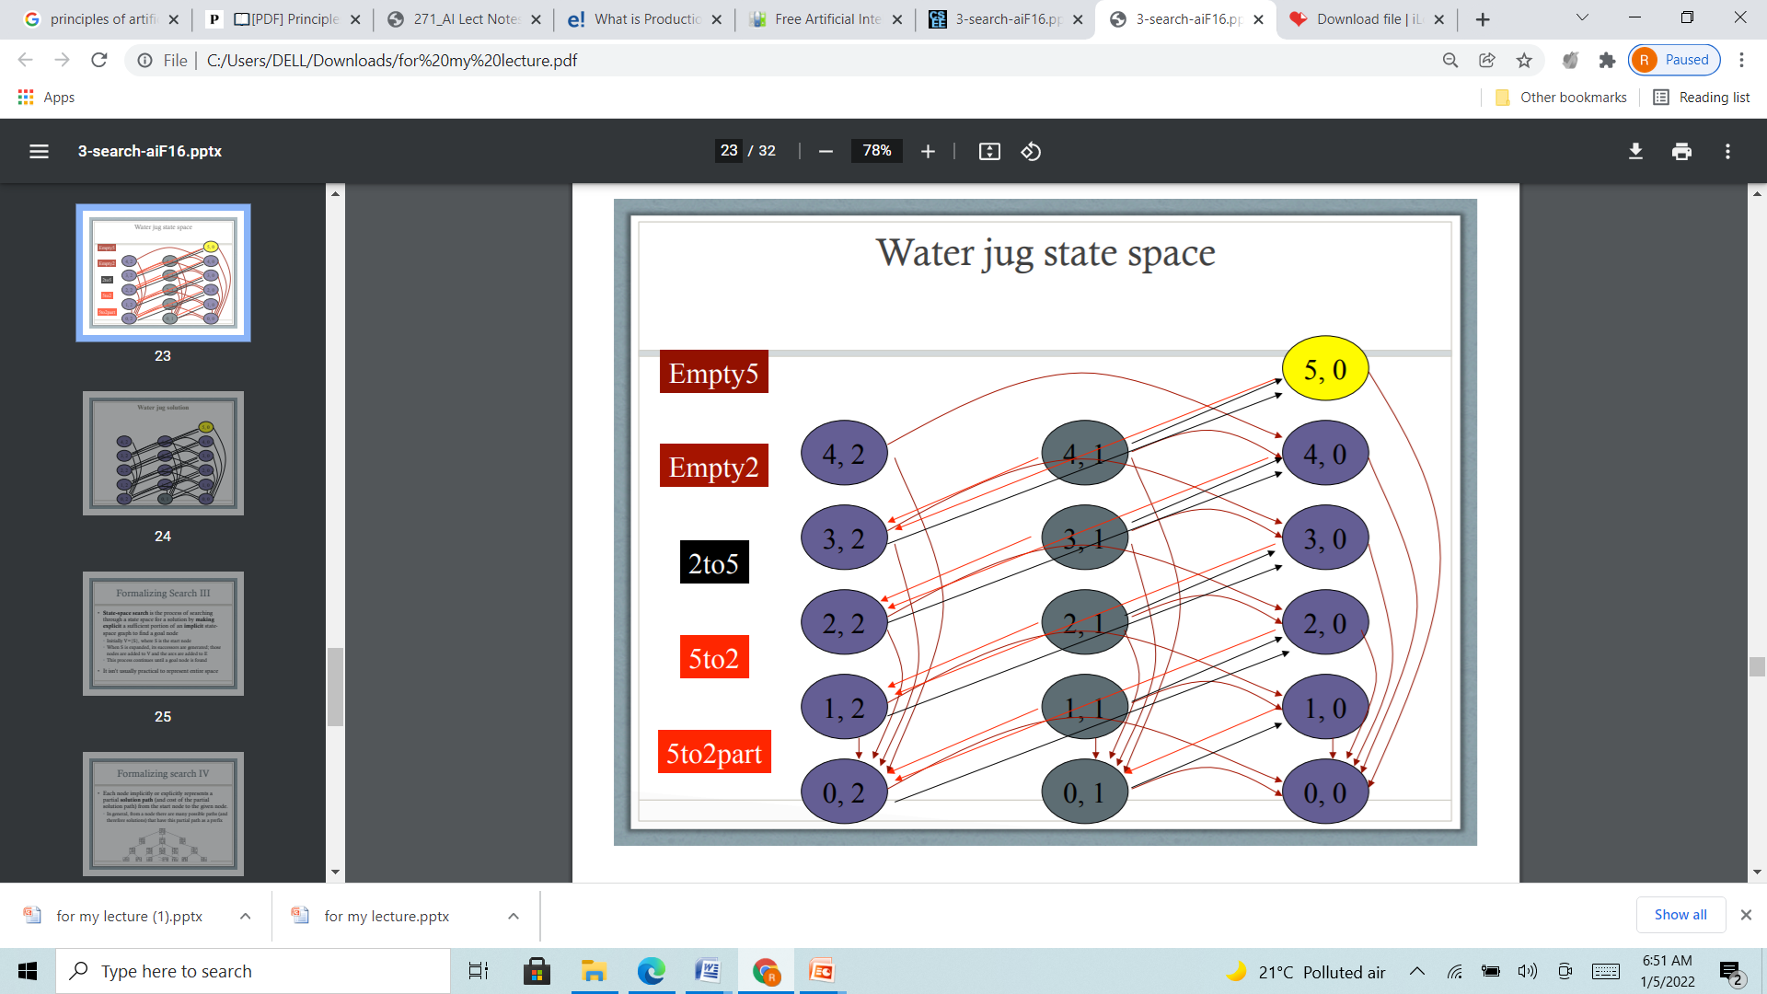
Water Jug Problem state Space(Graph)

Slide 5
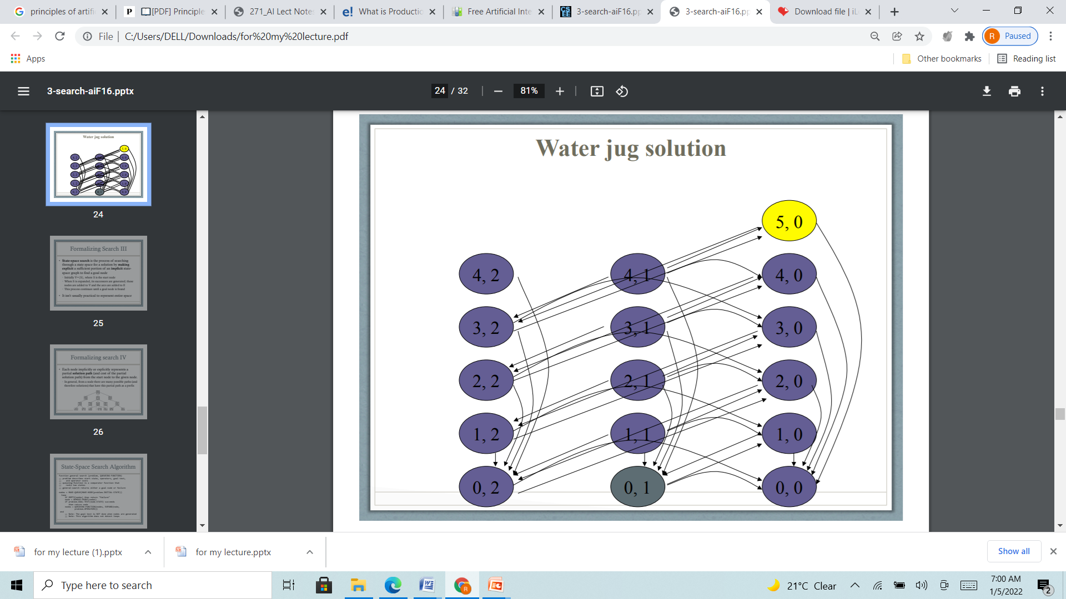

Slide 6
Water Jug Rpblem (Tree structure)
Rule set:
(x,y)->(4,y) : fill the 4 gallon jug If x<4
(x,y)->(x,3) : fill the 3 gallon jug If y<3
(x,y)->(x-d,y) : pour some water out of the 4-gallon jug If x>0
(x,y)->(x,y-d) : pour some water out of the 3-gallon jug.If y>0
(x,y)->(0,y) : empty the 4-gallon jug on the ground If x>0
(x,y)->(x,0) : empty the 3-gallon jug on the ground If y>0
(x,y)->(4,y-(4-x)) pour water from the 3-gallon jug into the 4-gallon If x+y>=4 and y>0 jug until the 4-gallon jug is full
(x,y)->(x-(3-y),3)) pour water from the 4-gallon jug into the 3-gallon If x+y>=3 and x>0 jug until the 3-gallon jug is full.
(x,y)->(x+y,0) pour all the water from the 3-gallon jug into If x+y<=4 and y>0 the 3-gallon jug.
(x,y)->(0,x+y) pour all the water from the 4-gallon jug into If x+y<=3 and x>0 the 3-gallon jug.
(0,2)->(2,0) pour the 2-gallon from the 3-gallon jug into the 4-gallon jug.
(2,y)->(0,x) empty the 2 gallon in the 4 gallon on the ground

Slide 7
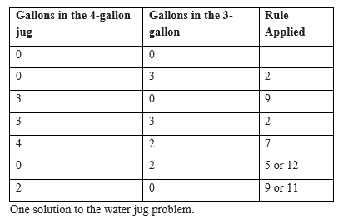
Production of the Water Jug Problem

Slide 8
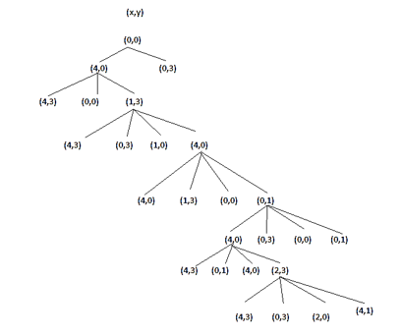
Search in the state space

Slide 9
8 Puzzle problem
The program is to change the initial configuration into the goal configuration.
A solution to the problem is an appropriate sequence of moves, such as “move tile 5 to the right, move tile 7 to the left, move tile 6 to the down” etc…
To solve a problem, we must specify the
Global database(Problem staes)
Rules(Moves and control strategy )
Goal
In this problem each tile configuration is a state.
The set of all possible configuration in the problem space, consists of 3,62,880 different configurations of the 8 tiles and blank space.
For the 8-puzzle, a straight forward description is a 3X3 array of matrix of numbers.

Slide 10
8 puzzle problem
The 8-puzzle is conveniently interpreted as having the following moves
Move empty space (blank) to the left, move blank up, move blank to the right and move blank down.
These moves are modeled by production rules that operate on the state descriptions in the appropriate manner
The goal condition forms the basis for the termination.
The control strategy repeatedly applies rules to state descriptions until a description of a goal state is produced.
It also keeps track of rules that have been applied so that it can compose them into sequence representing the problem solution.

Slide 11
Task1: Defining State and Search Space
A state is a representation of problem elements at a given moment.
A State space is the set of all states reachable from the initial state.
A state space forms a graph in which the nodes are states and the arcs between nodes are actions.
In the state space, a path is a sequence of states connected by a sequence of actions.
The solution of a problem is part of the graph formed by the state space.
The state space representation forms the basis of most of the AI methods.
Its structure corresponds to the structure of problem solving in two important ways:
It allows for a formal definition of a problem as per the need to convert some given situation into some desired situation using a set of permissible operations.
It permits the problem to be solved with the help of known techniques and control strategies to move through the problem space until goal state is found.

Slide 12
Task 2: Defining Problem & Search
A problem is described formally as:
Define a state space that contains all the possible configurations of relevant objects
initial states : Specify one or more states within that space that describe possible situations form which the problem solving process may start
goal states : Specify one or more states that would be acceptable as solutions to the problem
Specify a set of rules that describe the actions available.
Search Process: The problem can then be solved by using the rules, in combination with an appropriate control strategy, to move through the problem space until a path from an initial state to a goal state is found

Slide 13
Task 2: Search strategy
Search is fundamental to the problem-solving process
Search is a general mechanism that can be used when more direct method is not known
Search also provides the framework into which more direct methods for solving subparts of a problem can be embedded

Slide 14
Task 1: Define all Possible states
(0,1,2,3,4,5,6,7,8)

Slide 15
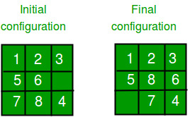
Task 1: Selelct Initial and Goal state
Initial: (1,2,3,5,6,0,7,8,4)
(_,X,X,_,X,X,_,X,X)
Goal : (1,2,3,5,8,6,0,7,4)

Slide 16
Rules for Movement
Shift the Empty tile one Position left
Shift the Empty tile one Position right
Shift the Empty tile one Position Up
Shift the Empty tile one Position Down
Condition for Movement
Check for the left most position of the empty tile
Check for the right most position of the empty tile
Check for the top most position of the empty tile
Check for the bottom most position of the empty tile

Slide 17
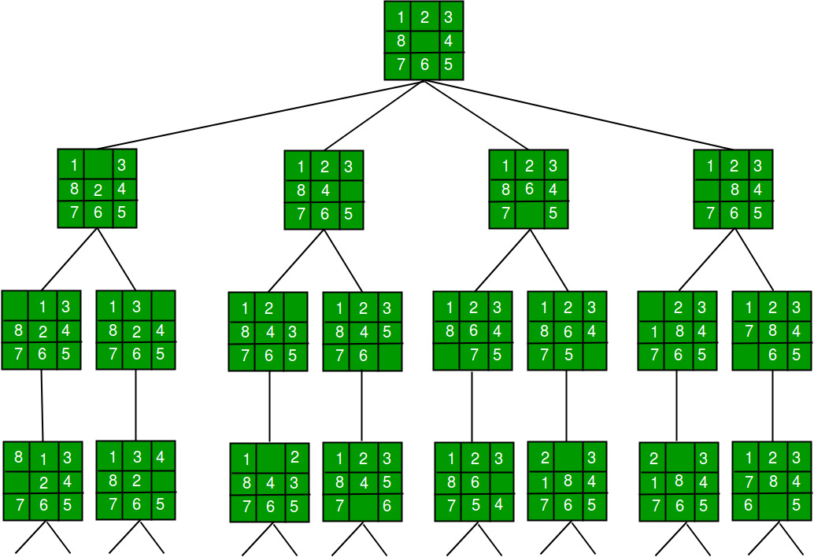
Task 2: Define Search Space

Slide 18
Task 2: Select Solution path using Search strategy
1. DFS
Select one branch (Generate and test is possible)
Explore the branch till the leaf level
Search space should not contain any repeated state
If
solution is found stop
Else
back track and continue the task

Slide 19
Task 2: Select Solution path using Search strategy
2. BFS (Brute-Force)
Generate complete search space(Level wise generation is possible)
perform a Breadth-first search on the state space tree.
always finds a goal state nearest to the root

Slide 20
Task 2: Select Solution path using Search strategy
3. Branch and Bound The search for an answer node can often be speeded by using an “intelligent” ranking function, also called an approximate cost function to avoid searching in sub-trees that do not contain an answer node. It is similar to the backtracking technique but uses a BFS-like search.
There are basically three types of nodes involved in Branch and Bound 1. Live node is a node that has been generated but whose children have not yet been generated. 2. E-node is a live node whose children are currently being explored. In other words, an E-node is a node currently being expanded. 3. Dead node is a generated node that is not to be expanded or explored any further. All children of a dead node have already been expanded.

Slide 21
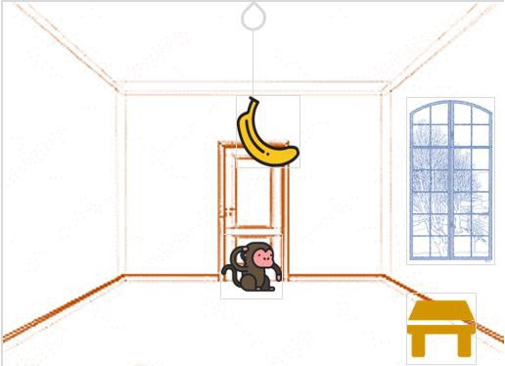
Monkey banana Problem
Problem Statement
A hungry monkey is in a room, and he is near the door
The monkey is on the floor
Banana is hung from the center of the ceiling of the room
There is a block (or chair) present in the room near the window
The monkey wants the banana, but cannot reach it

Slide 22
The Monkey Banana Problem
Strategy
Monkey can come to the block, drag the block to the center, climb on it, and get the banana.
Below are few observations in this case −
Monkey can reach the block, if both of them are at the same level.
From the above image, we can see that both the monkey and the block are on the floor.
If the block position is not at the center, then monkey can drag it to the center.
If monkey and the block both are on the floor, and block is at the center, then the monkey can climb up on the block.
So the vertical position of the monkey will be changed.
When the monkey is on the block, and block is at the center, then the monkey can get the bananas.

Slide 23
The Monkey Banana Problem (State Desccription)
Initial State
Monkey is on the ground
Monkey is Not in the Center
Box is on the ground
Box is not in the center
State (0,P1,0,P2)
Goal State
Monkey is on the Box
Box is in the center
Monkey has banana
Action
Monkey Walk to the Box
Monkey drag the box from Position1 to Center
Monkey Climb the Box
Monkey has banana

Slide 24
The Monkey Banana Problem (State Description)
Sate() as a predicate
Monkey Position in the room (Middle, or not )
Monkey Position related to box (On the Box or not)
Box Position (Middle, or not)
Banana status (has, or hasnot)
E.g. state(MIDDLE,1,MIDDLE,0,hasnot)
Grasp() as a predicate
E.g. grasp(stae(stae(middle,onbox,middle,hasnot),stae(middle,onbox,middle,has))

Slide 25
Prolog Predicates to the Monkey Banana Problem
Here Four different moves are defined with Single predicate “move”
State(P1,0,p2,0)
state(middle,onbox,middle,hasnot) →state(middle,onbox,middle,has)
move(state(middle,onbox,middle,hasnot), grasp, state(middle,onbox,middle,has))
move(state(P,onfloor,P,H), climb, state(P,onbox,P,H))
move(state(P1,onfloor,P1,H), drag(P1,P2), state(P2,onfloor,P2,H)).
move(state(P1,onfloor,B,H), walk(P1,P2), state(P2,onfloor,B,H)).
canget(state(_,_,_,has)).
canget(State1) :- move(State1,_,State2), canget(State2).

Slide 26
Monkey banana Problem : 2
A monkey is in a cage and bananas are suspended from the ceiling, the monkey wants to eat a banana but cannot reach them
in the room are a chair and a stick
if the monkey stands on the chair and waves the stick, he can knock a banana down to eat it
what are the actions the monkey should take?
Initial state:
monkey on ground
with empty hand
bananas suspended
Goal state:
monkey eating
Actions:
climb chair/get off
grab X
wave X
eat X

Slide 27
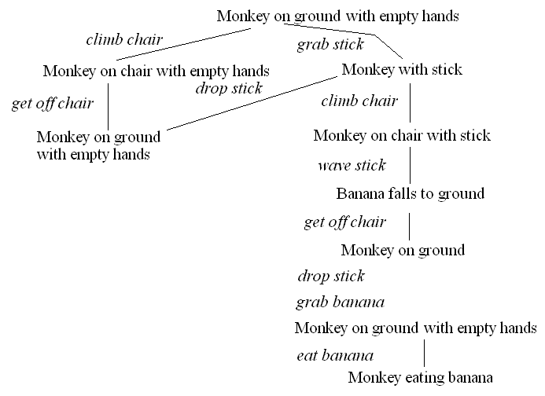
Monkey banana Problem : 2(Search Space)
Define state space (HW)

